Slide 1
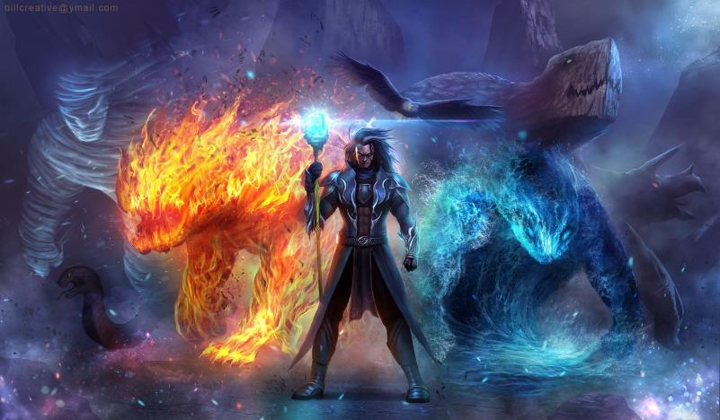
Beyond darkness

Slide 2
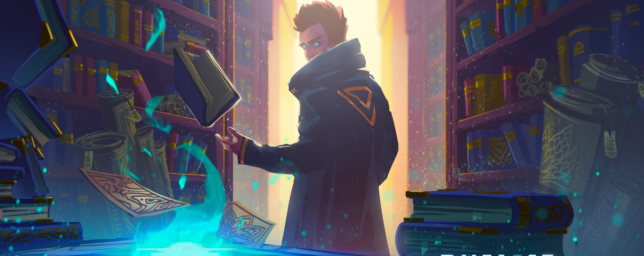
Description :
In a world full of sins, the Demons invade the globe as a punishment from God, and the epidemic spread in many dangerous and different forms. Our hero The wizard Balco dedicated his life to save as many patients as he can, despite all the danger he will face serving this cause.

Slide 3
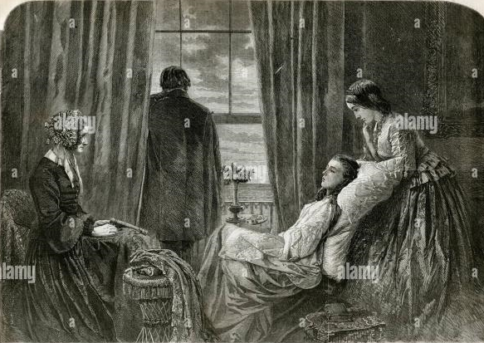
Scripts:
The game starts when he is in a hut of a poor family made up of a sick widow and her tow daughters, and he wants to cure her from the curse that has befallen her

Slide 4
The player has to choose one path: «south » « west » « north »

Slide 5
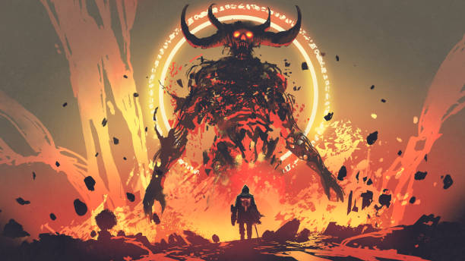
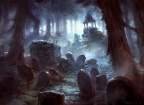
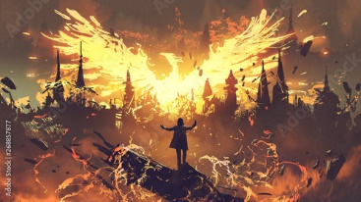
South:
First you have to kill the first Demon
Then choose between
Sacrificing yourself to kill all
the monsters and finish all the tragedies
continue and kill the second monster

Slide 6
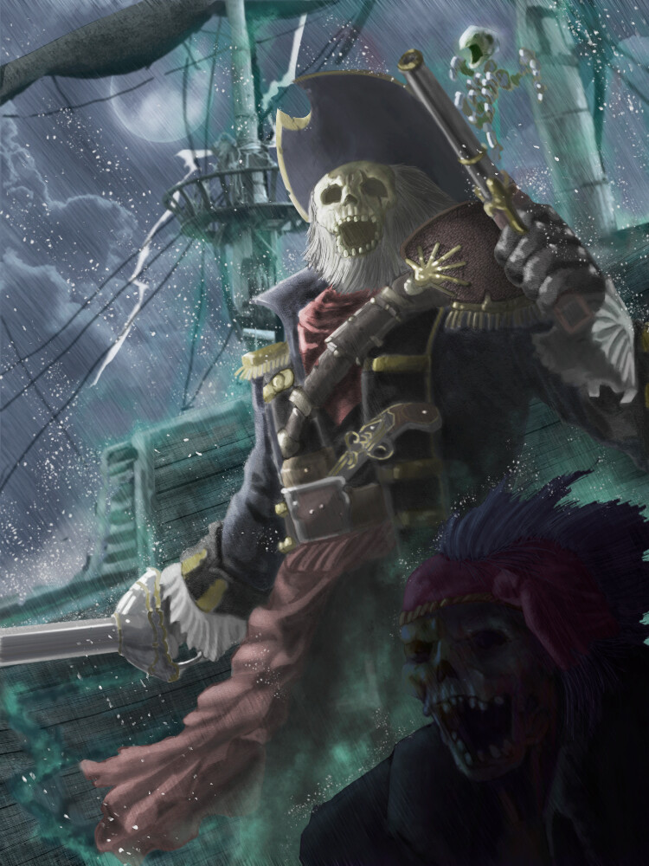
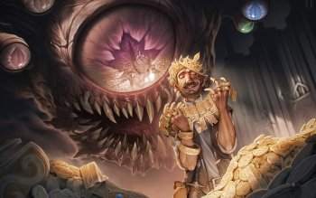
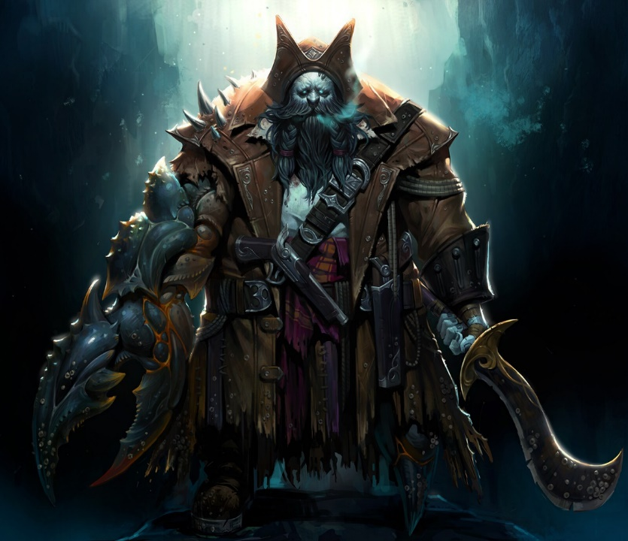
North:
First you have to kill the Pirate Demon.
Then choose between
Collect the treasure
Continue and kill the second Demon to save the sick mother

Slide 7
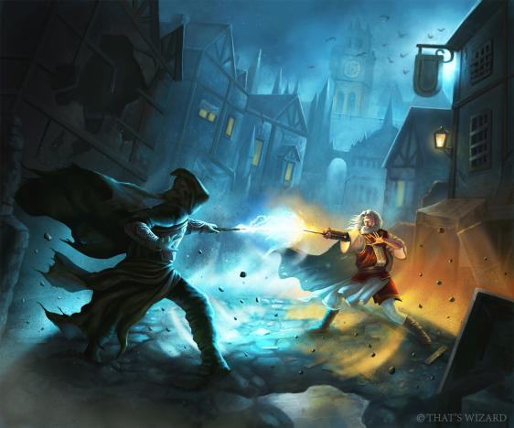
west You will find a very dark and scary house
If you choose to enter it, you have to choose between
Kill your son
Get betrayed by Zafir

Slide 8
Conclusion:
If you want to kill the monsters you have to answer all their questions correctly.
You have to choose wisely when you have multiple choices
Don’t be greedy, and deviate from your main goal.

Slide 9
Thank you
Ibrahim Nour
Rima Assaad
Hodhod

